Slide 1
QAOA Solutions and Comparison to the VQE
Youfu Qian
Feb 10th 2023

Slide 2
QAOA: Bipartite -> assign spins VQE: assign spin at every iteration

Slide 3
3x3 Model Without PBC

Slide 4
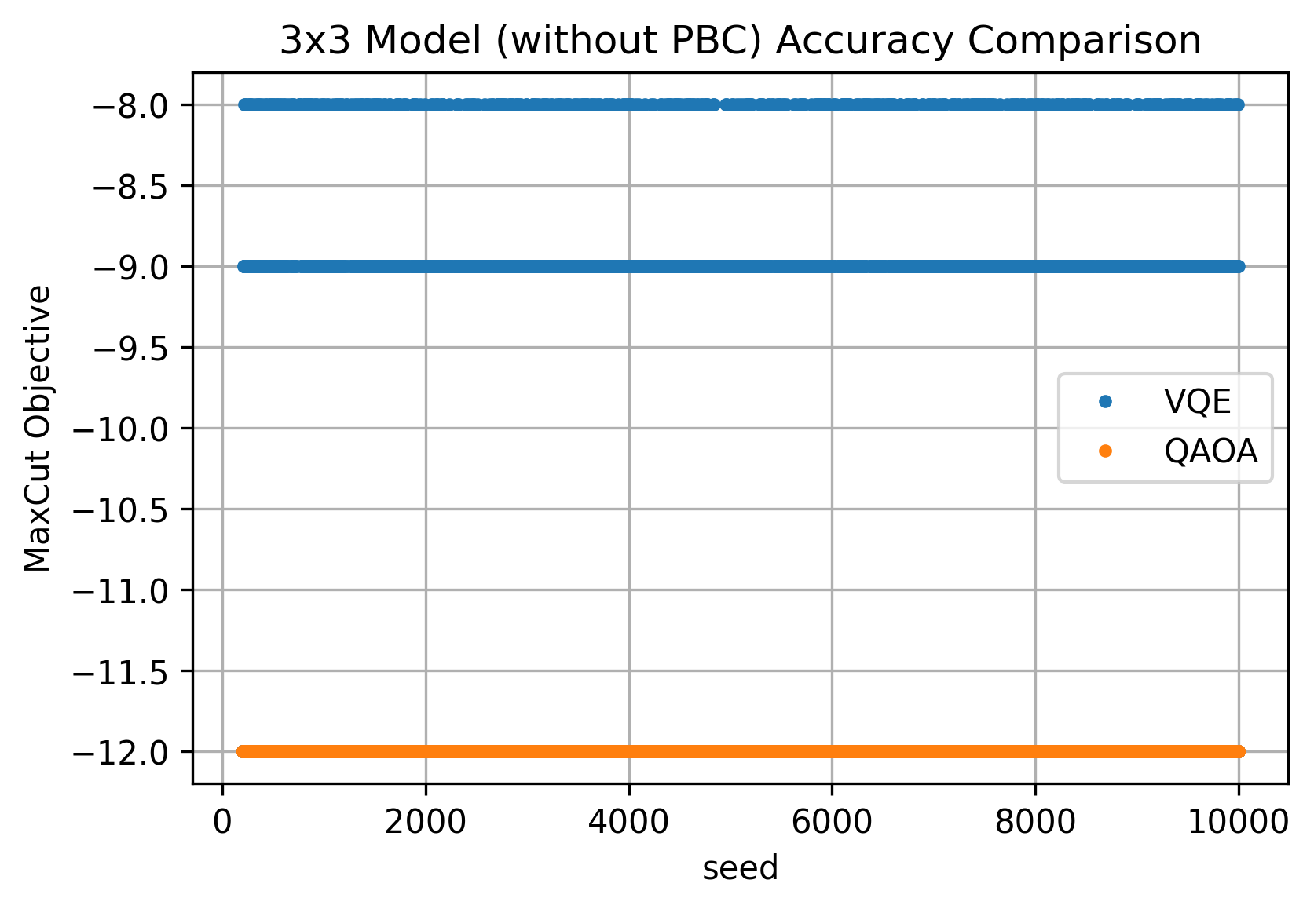
Accuracy
Algorithm | Backend | Optimizer
QAOA | aer | COBYLA
VQE | statevector | SLSQP

Slide 5
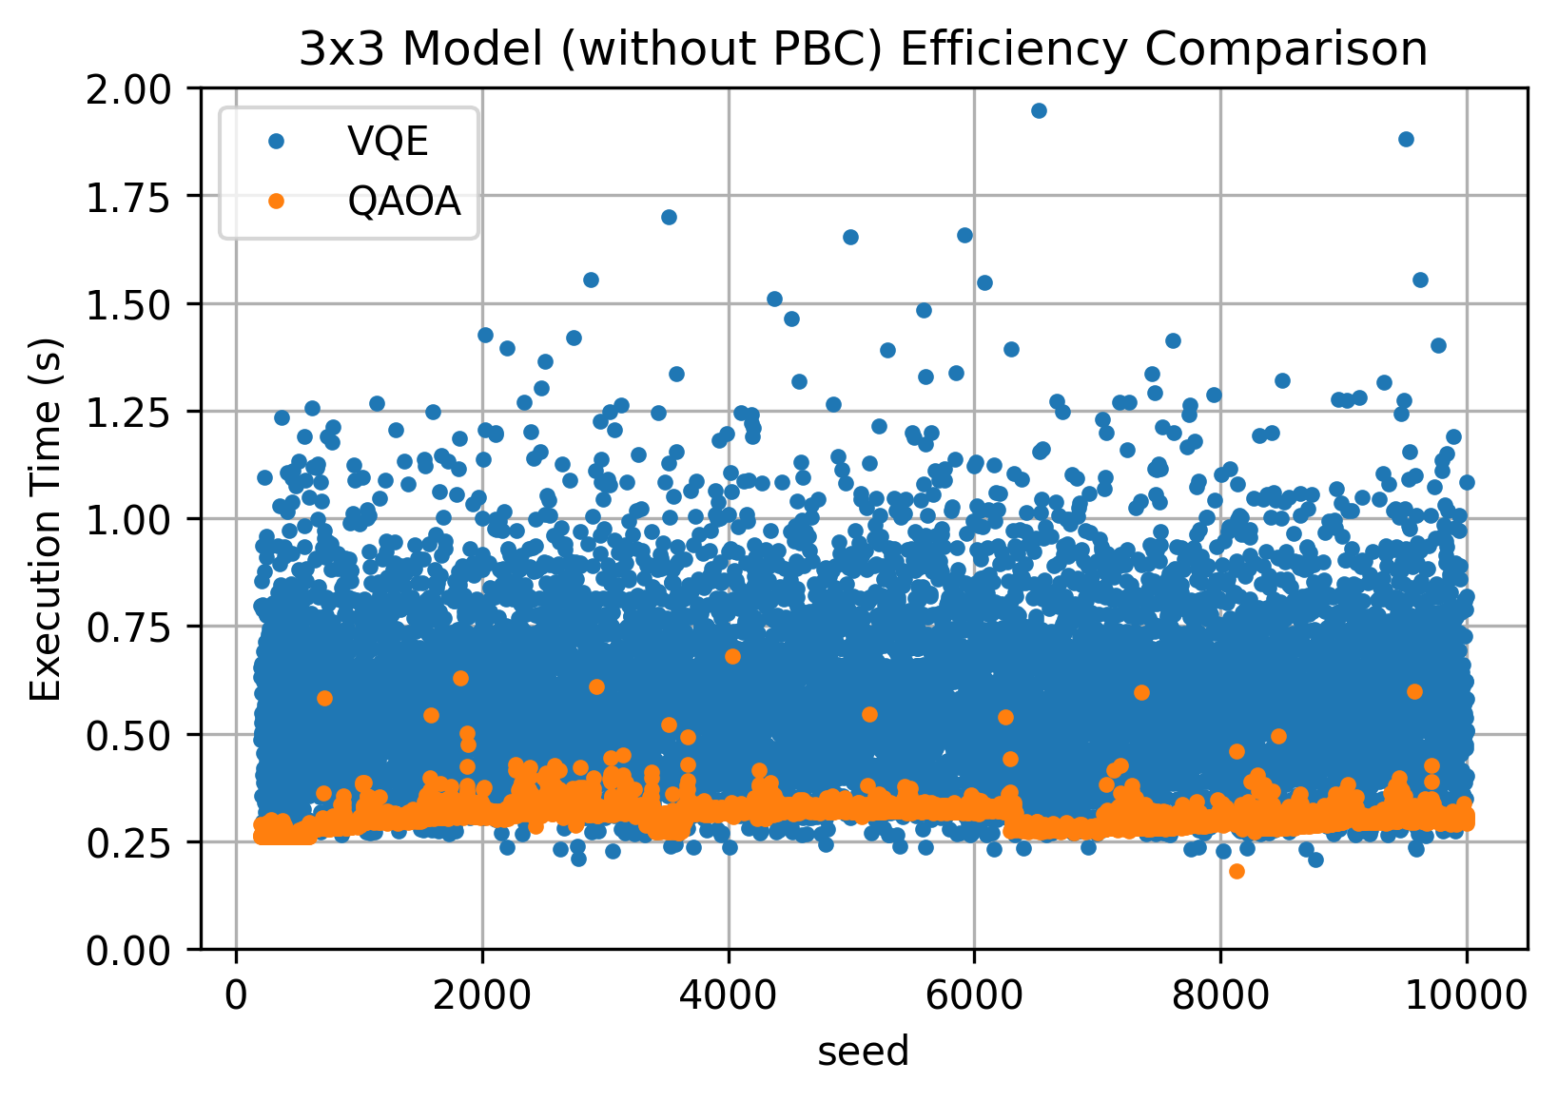
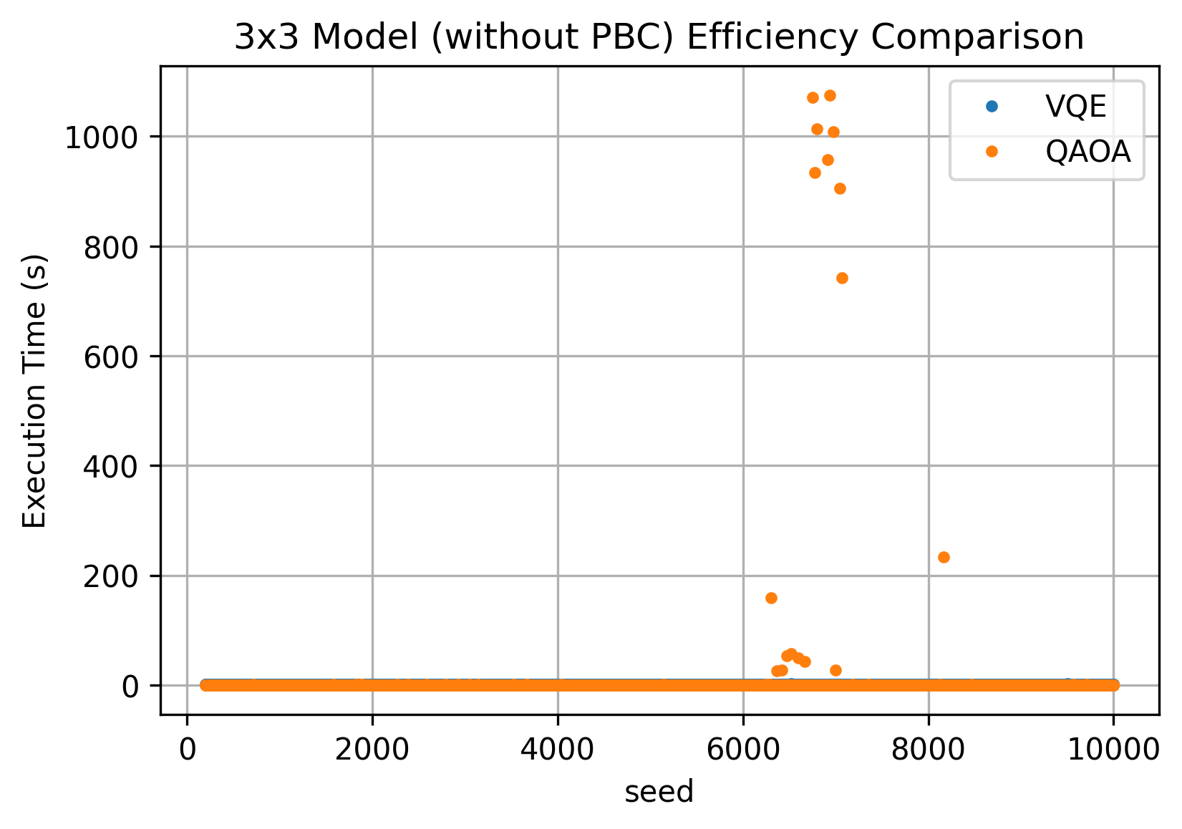
Efficiency

Slide 6
3x3 Model With PBC

Slide 7
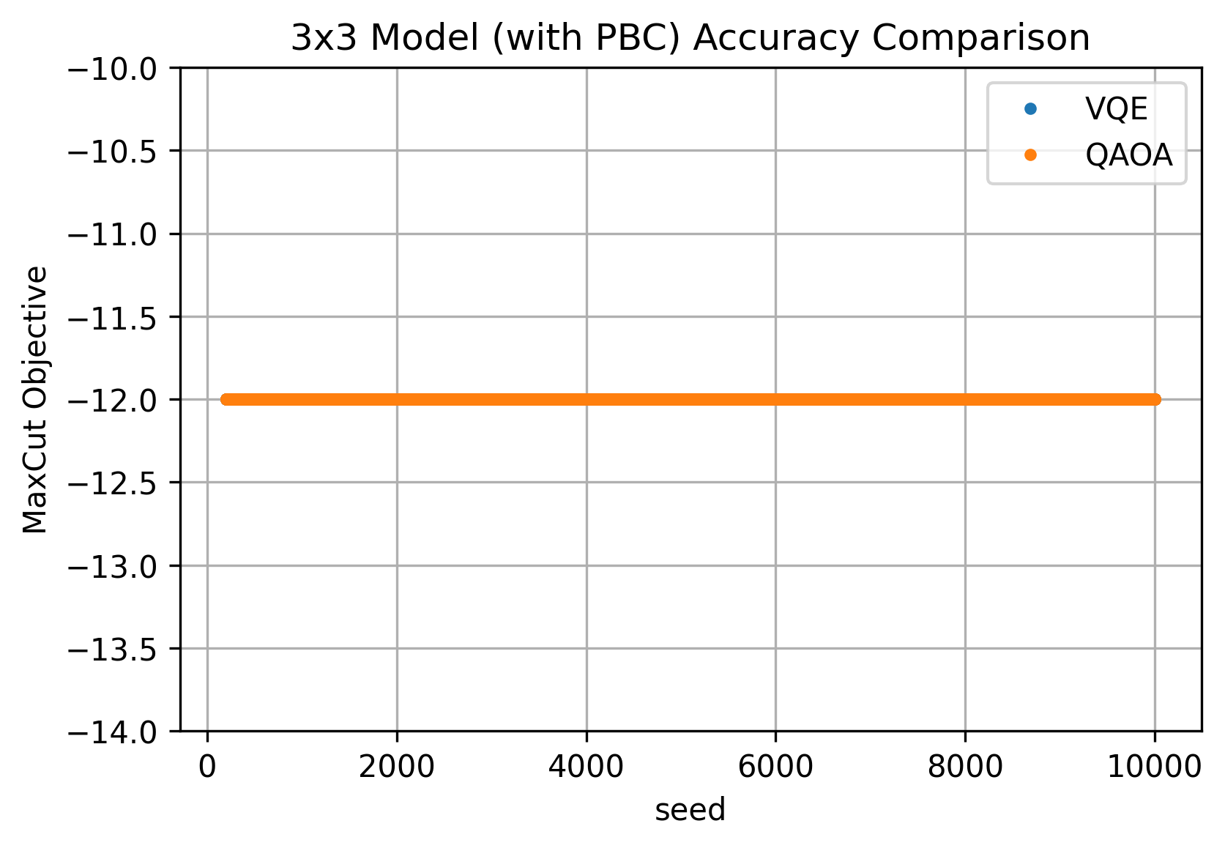
Accuracy

Slide 8
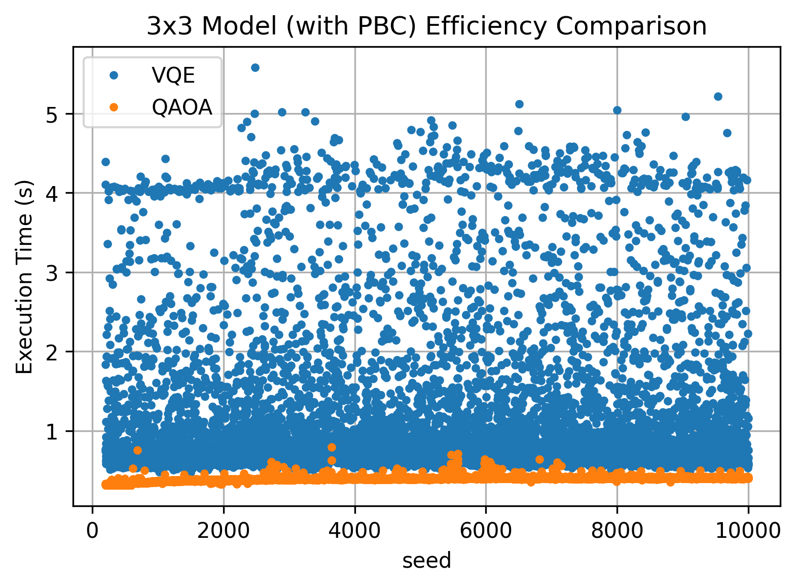
Efficiency

Slide 9
4x4 Model Without PBC

Slide 10
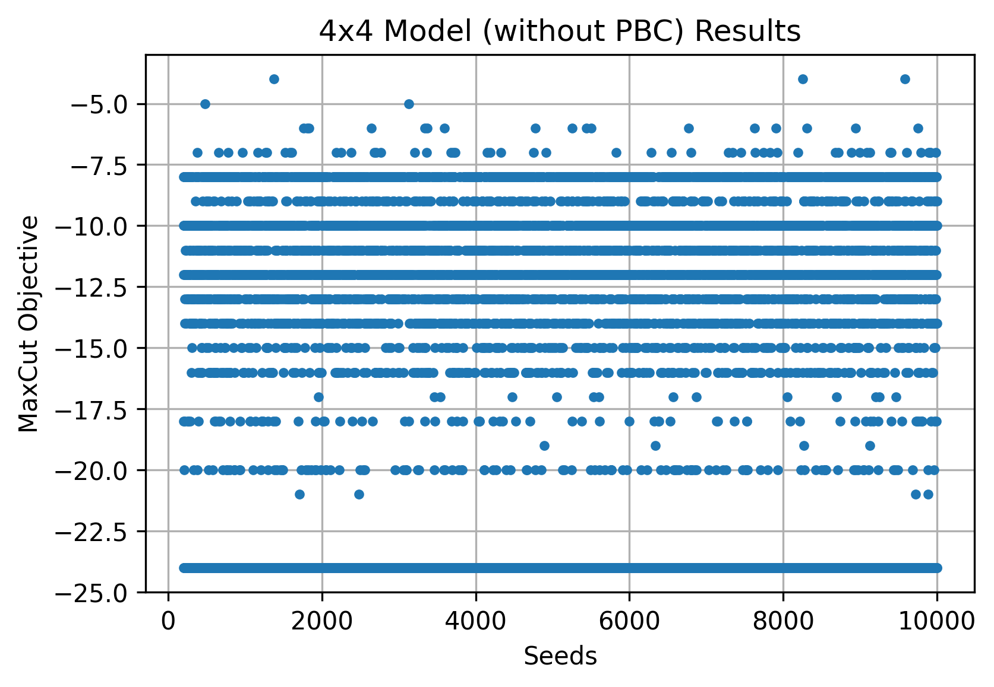
QAOA Results: WILD!
get_expectation seed = 10, backend.rum seed = vary

Slide 11
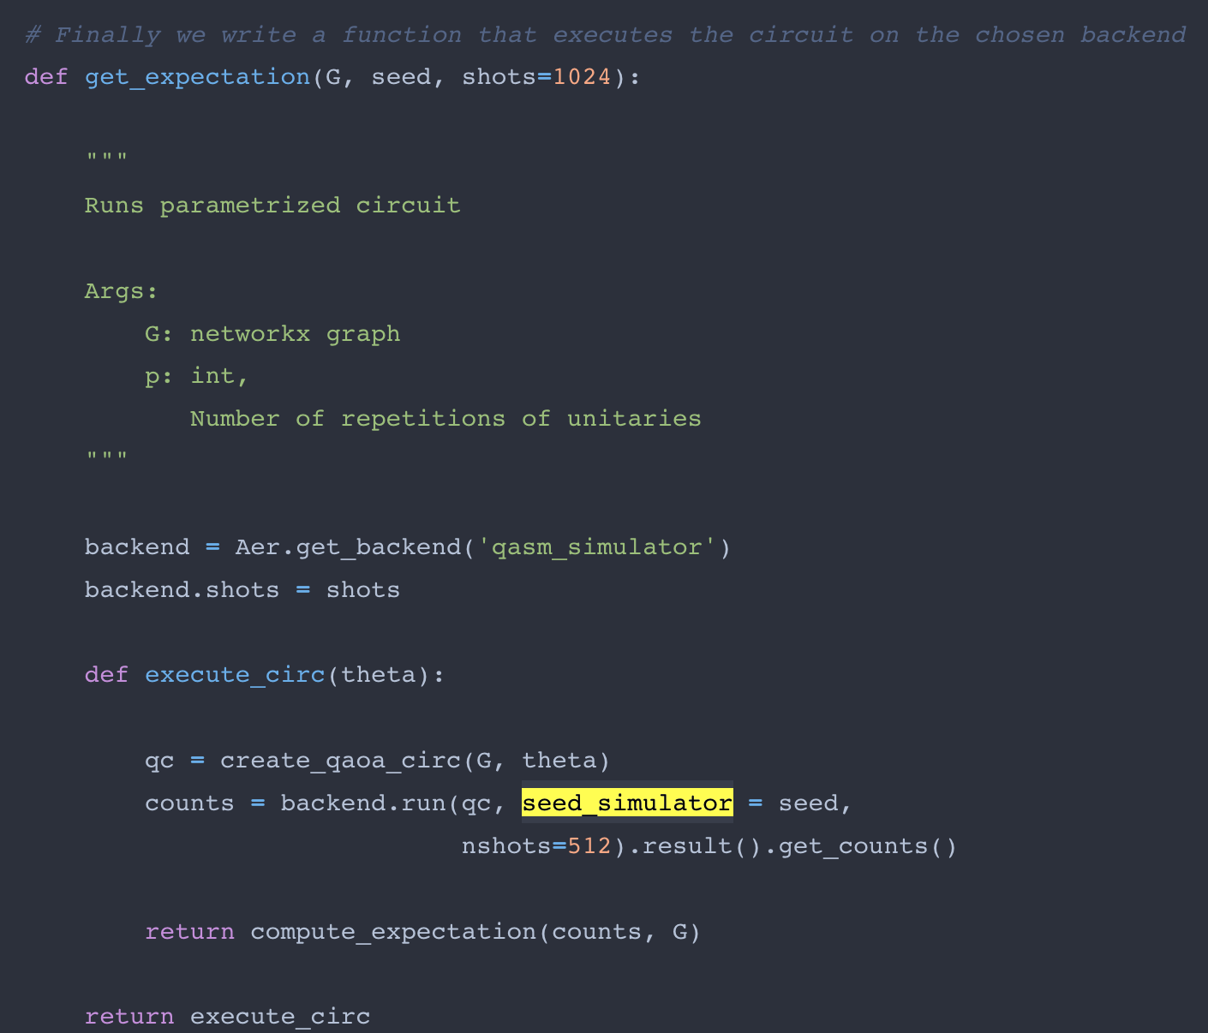
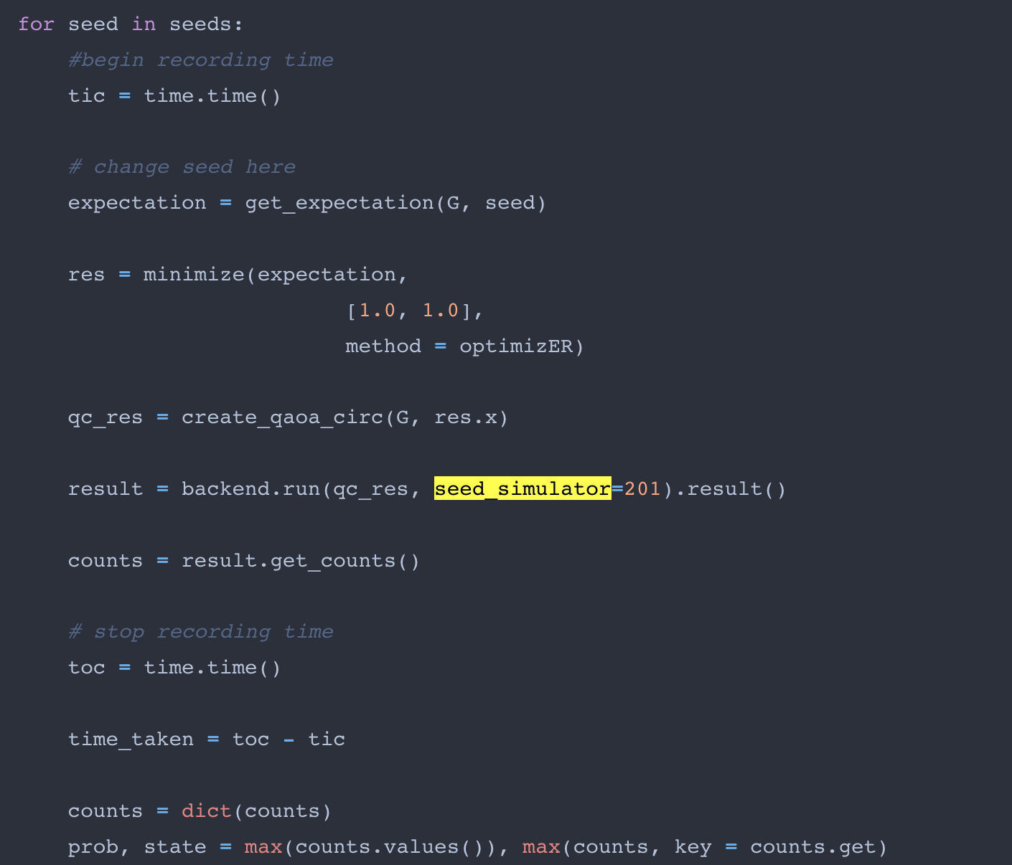
Two Places Have Seed Parameter

Slide 12
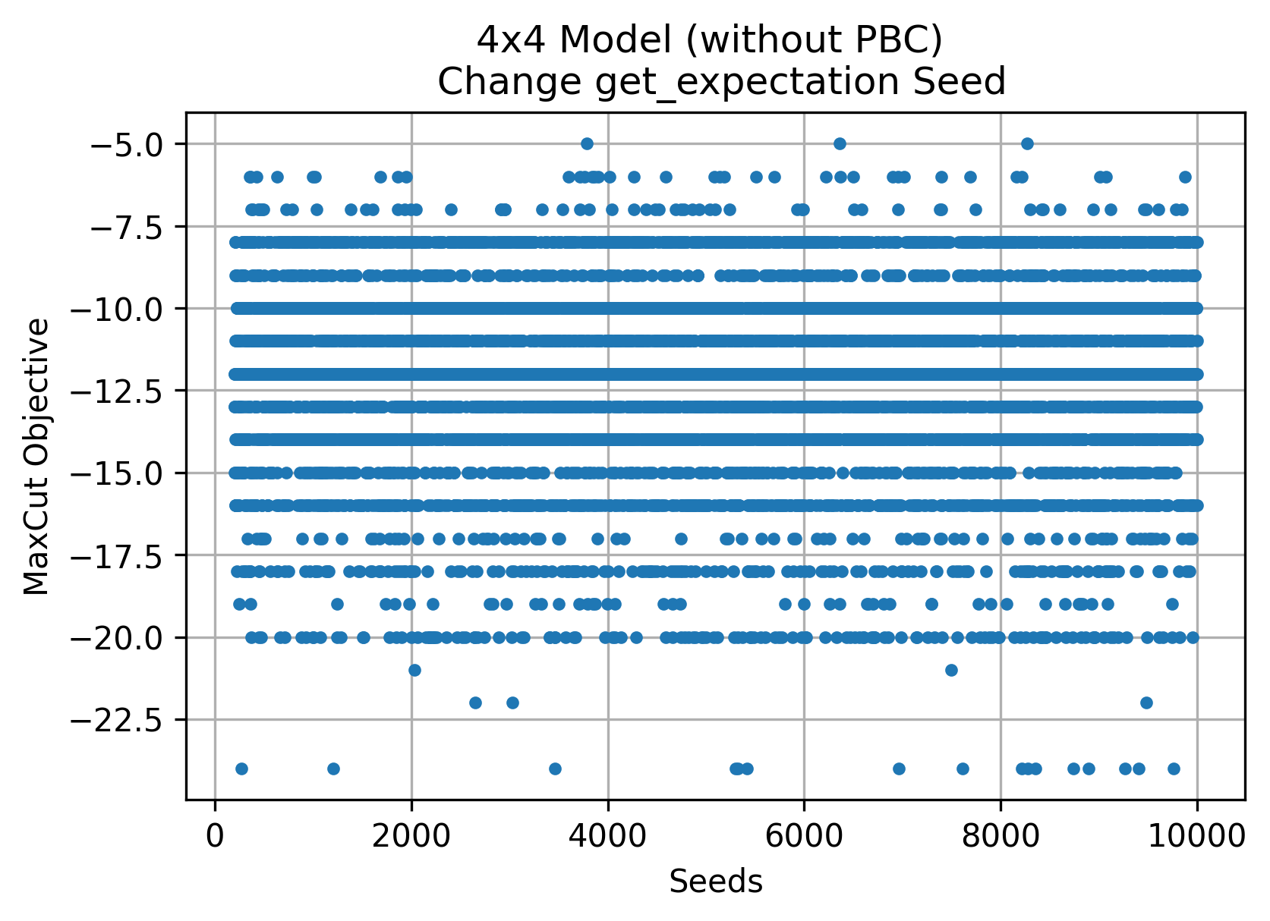
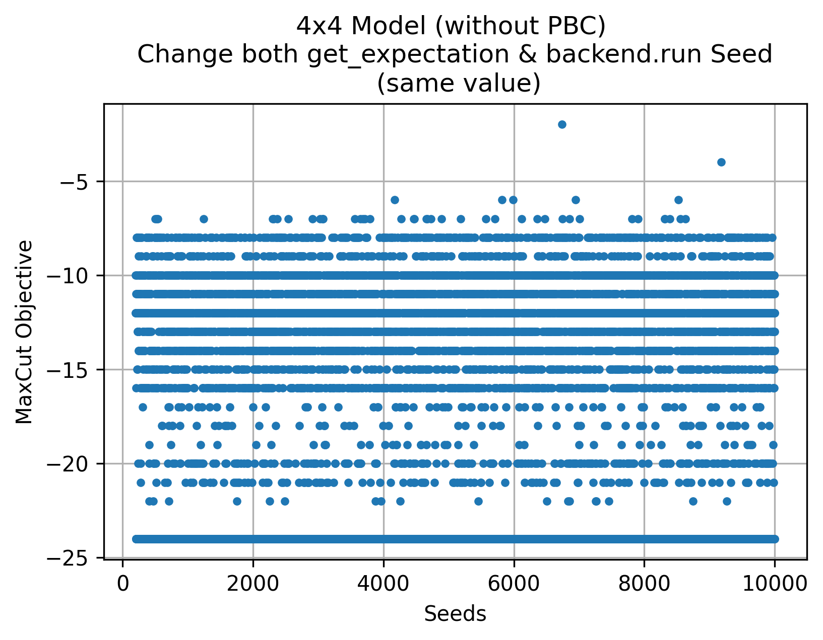
WILD! Not a good approach

Slide 13
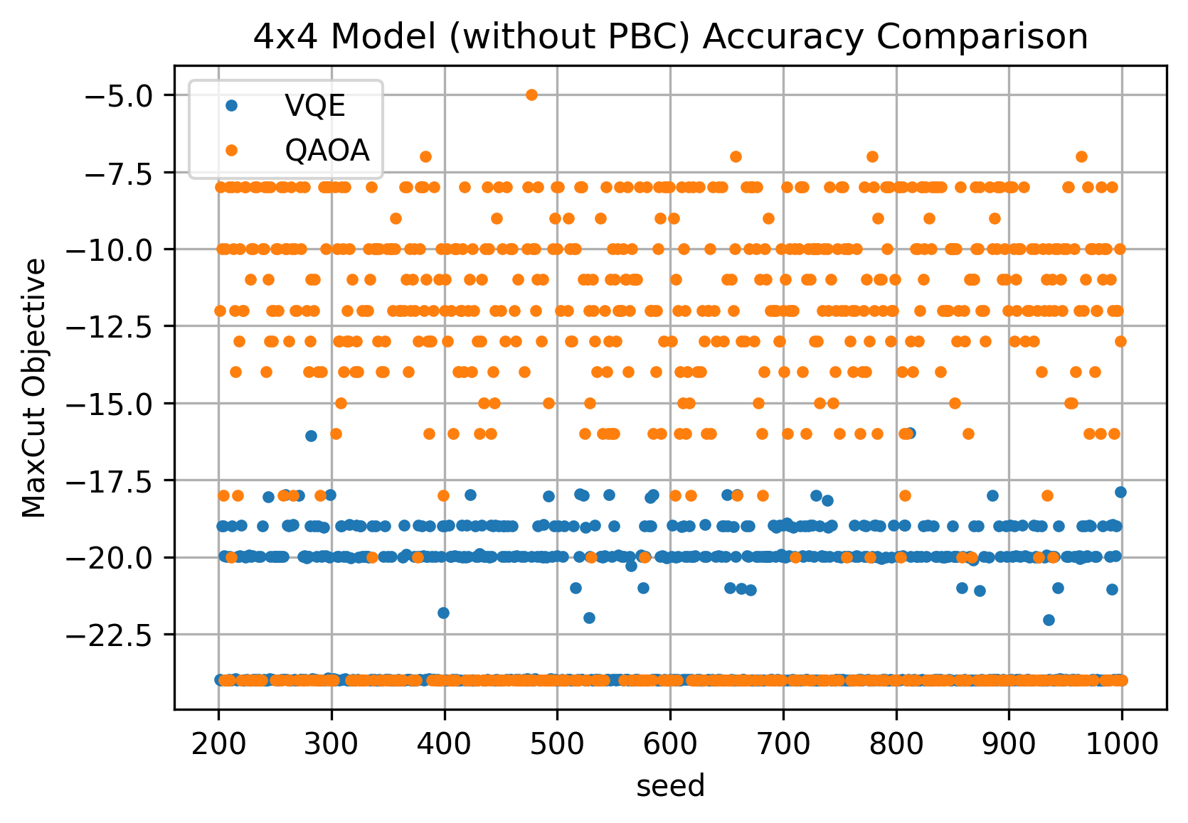
Accuracy
Algorithm | Backend | Optimizer
QAOA | aer | COBYLA
VQE | qasm | COBYLA

Slide 14
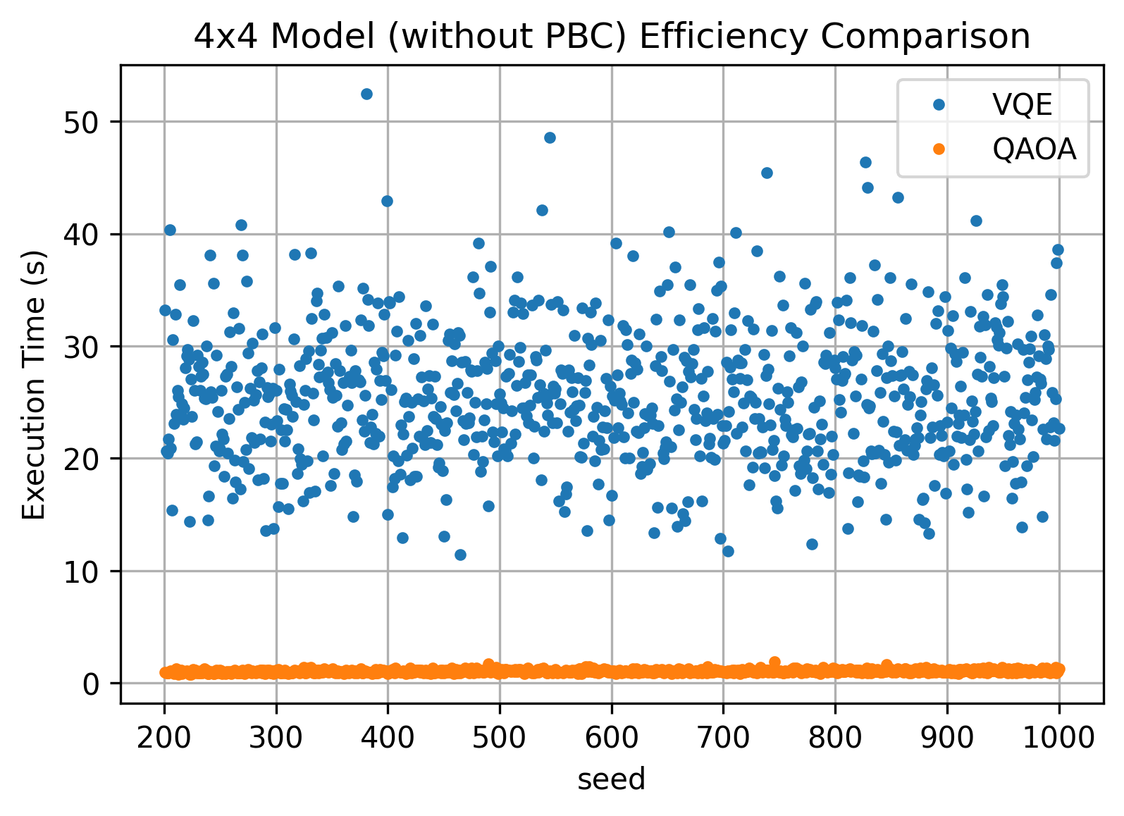
Efficiency

Slide 15
4x4 Model With PBC

Slide 16
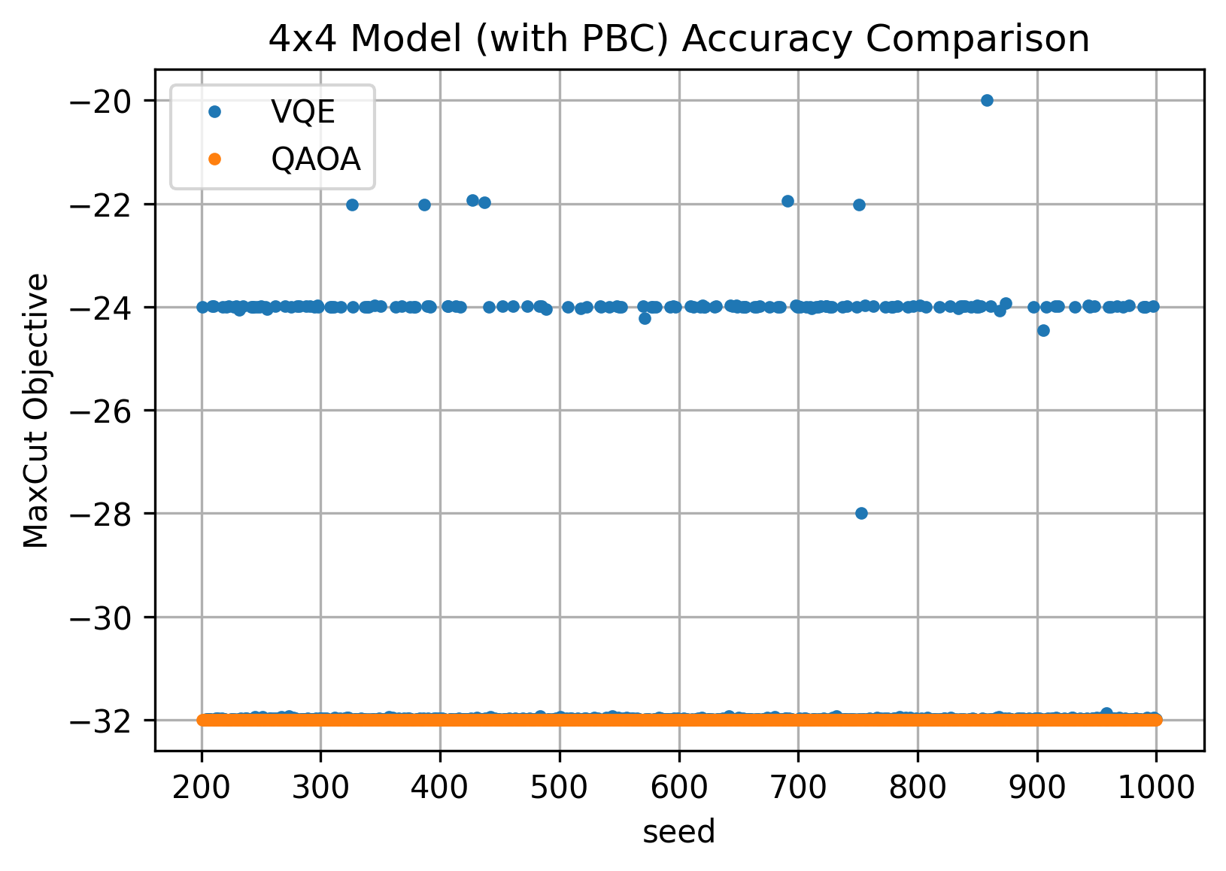
Accuracy
get_expectation seeds fixed
Change backend.run seed
Algorithm | Backend | Optimizer
QAOA | aer | COBYLA
VQE | qasm | COBYLA

Slide 17
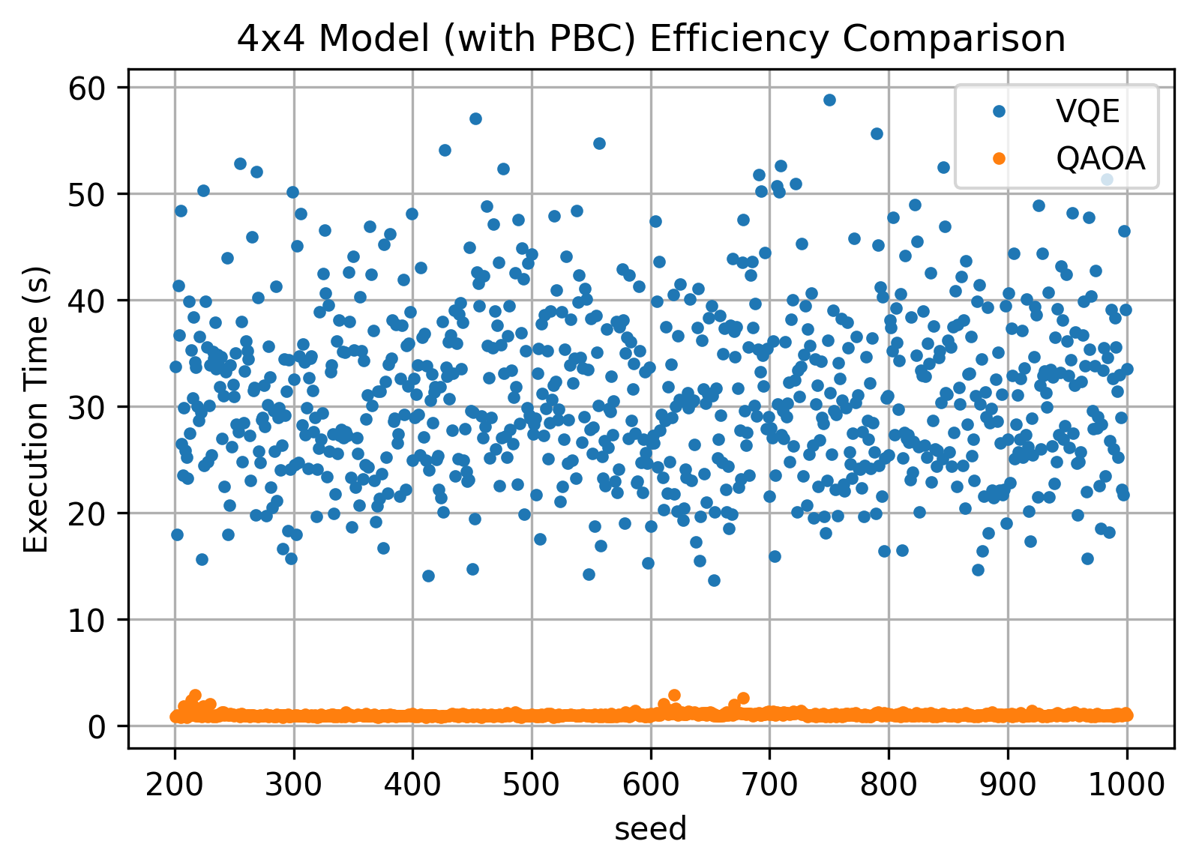
Efficiency

